Slide 1
Tutorial 3
Slides by TA Jeremy Lim

Slide 2
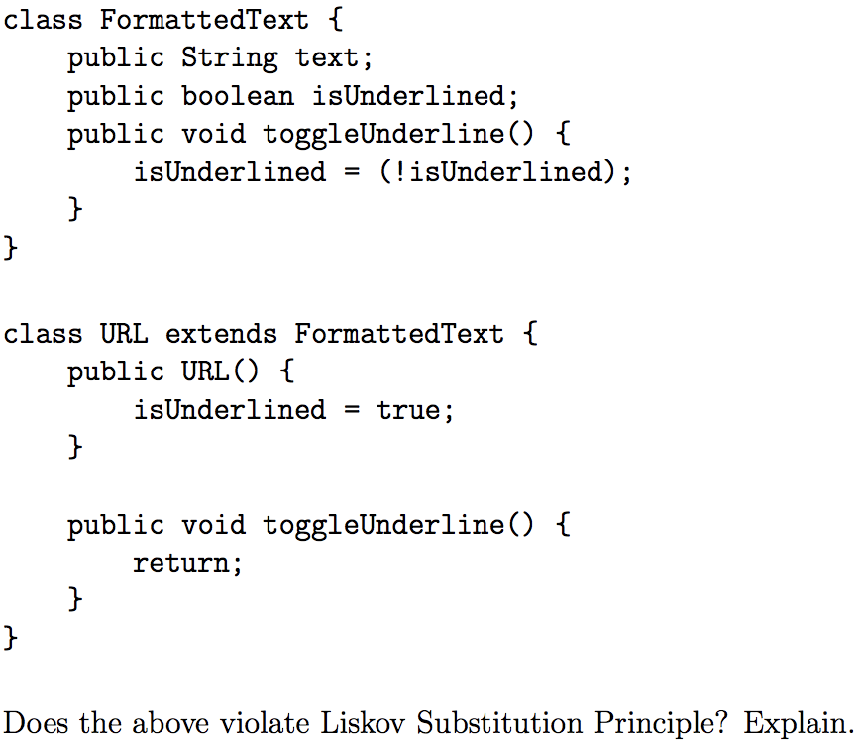
Q1
Does this violate LSP?

Slide 3
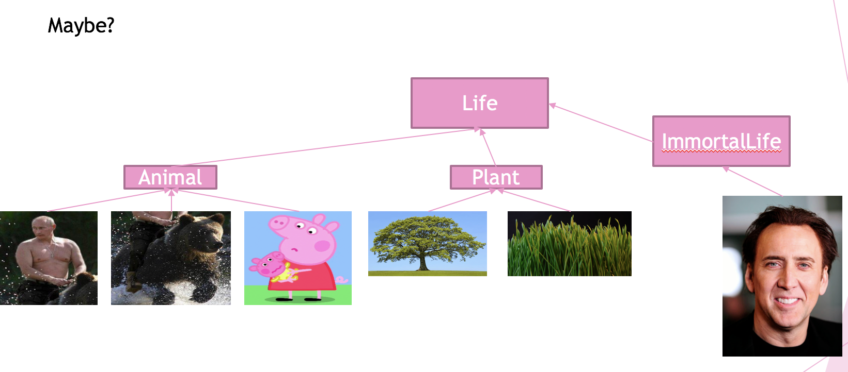
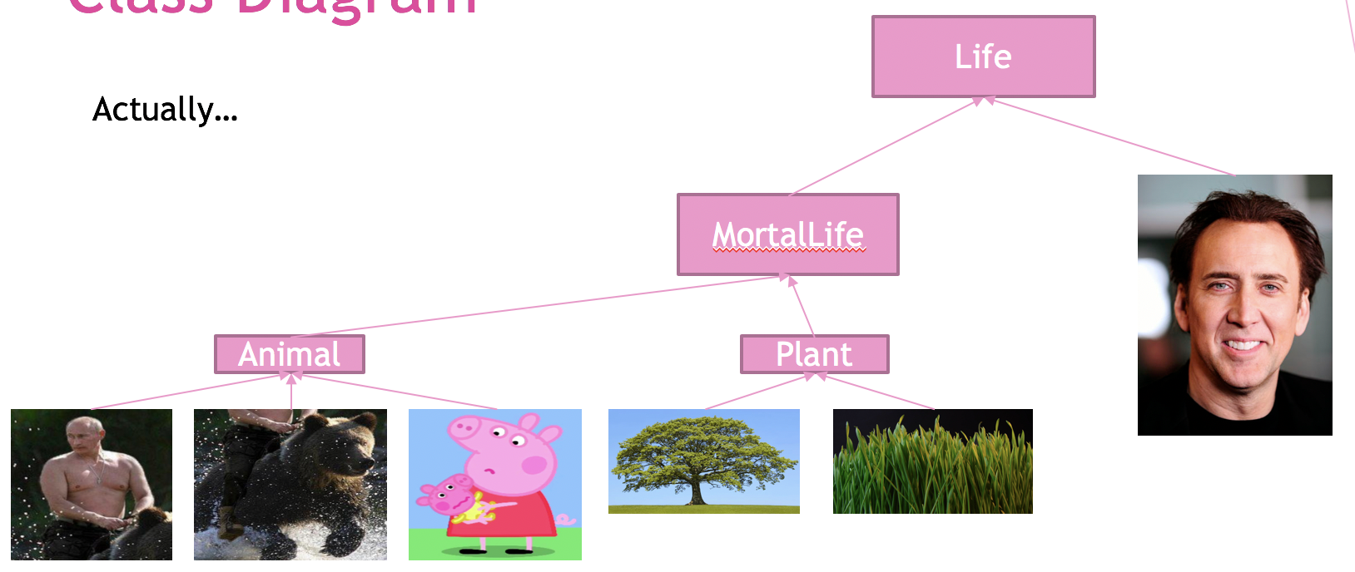
Recall
vs

Slide 4
Q1
Does this violate LSP?
Yes, the “desirable property” (purpose) of the method no longer holds as URL changes the behavior of toggleUnderline().

Slide 5
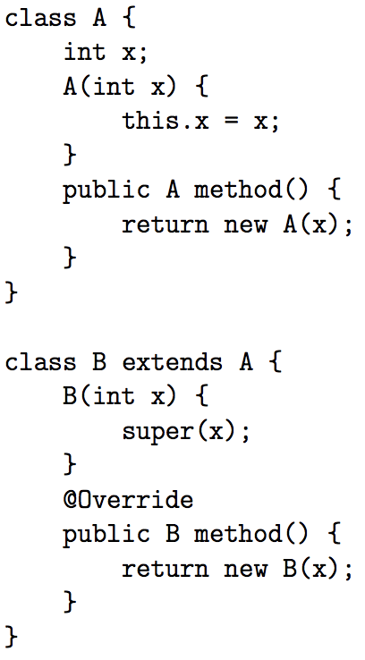
Q2
Does it compile?

Slide 6
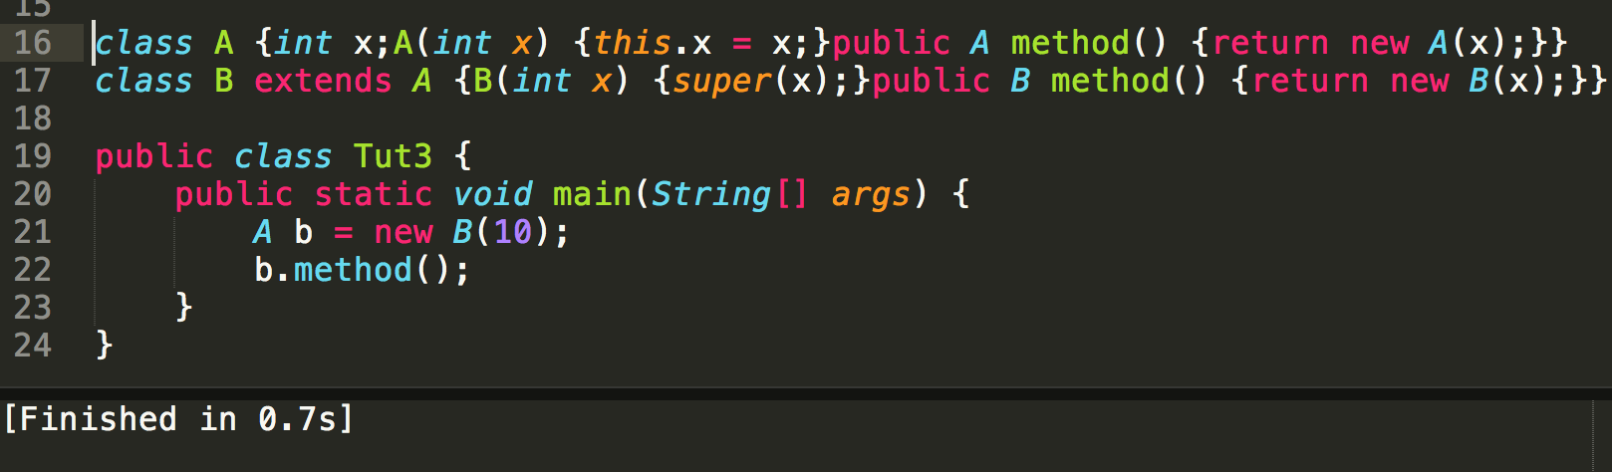
Yes.

Slide 7

Why?
A’s Methods
A method()
A’s Implementation
A method()
But the signatures don’t match!!!
B’s Methods
B method()
B’s Implementation
B method()
A
A method()
Still returns an instance of A
inherits
B
B method()

Slide 8
Q2
Does it compile?
B
B
A
A

Slide 9
No.
A’s Methods
B method()
A’s Implementation
B method()
A
A method()
B expected
inherits
B’s Methods
A method()
B’s Implementation
A method()
B
B method()
A received

Slide 10
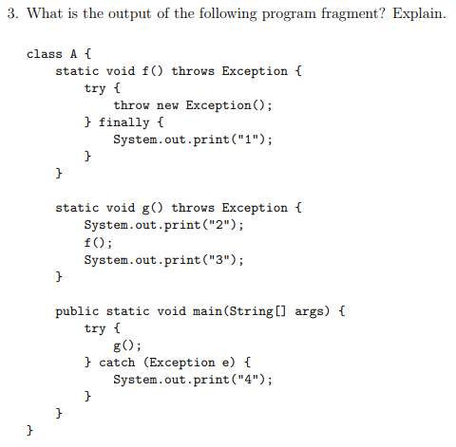
Q3
What is the output, and why?

Slide 11
Q3
3.
Key Point:
finally in a try-catch block executes before an external catch
4.
2.
Skipped
1.
5.

Slide 12
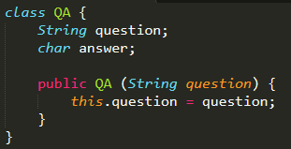
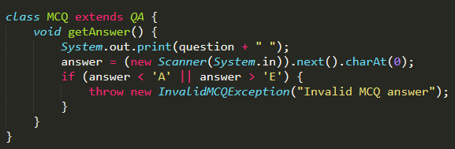
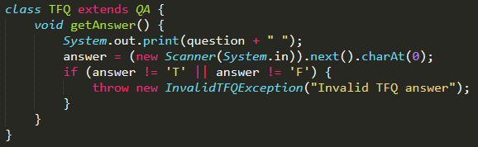
Q4
Abstract out common code in TFQ and MCQ to a common place QA
MCQ and TFQ inherits from QA
InvalidMCQException and InvalidTFQException extends InvalidAnswerException

Slide 13
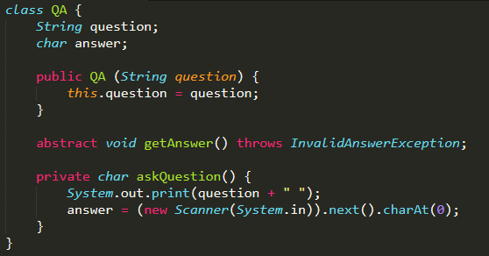
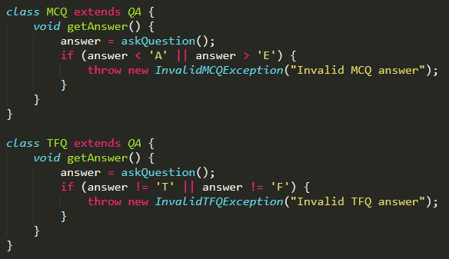
Q4
2 ways from here: First – Abstract input

Slide 14
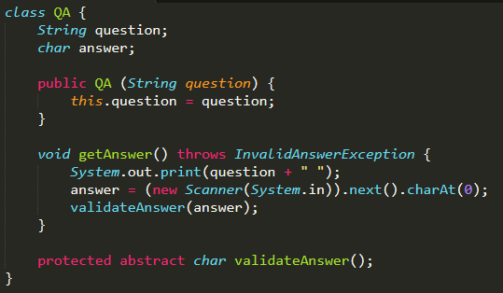
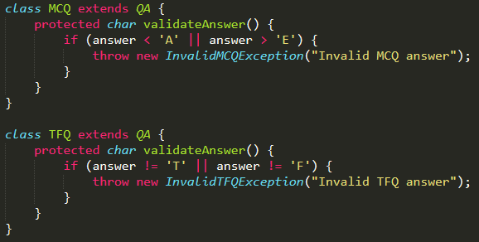
Q4
2 ways from here: Second – Abstract validation

Slide 15
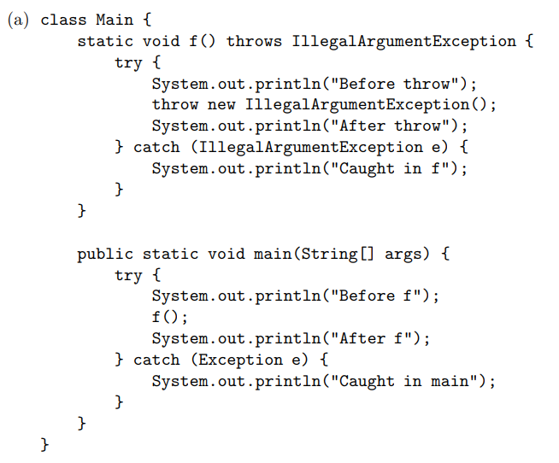
Q5
2.
Unreachable statement
Key Point:
Exception caught in first catch
3.
1.
4.

Slide 16
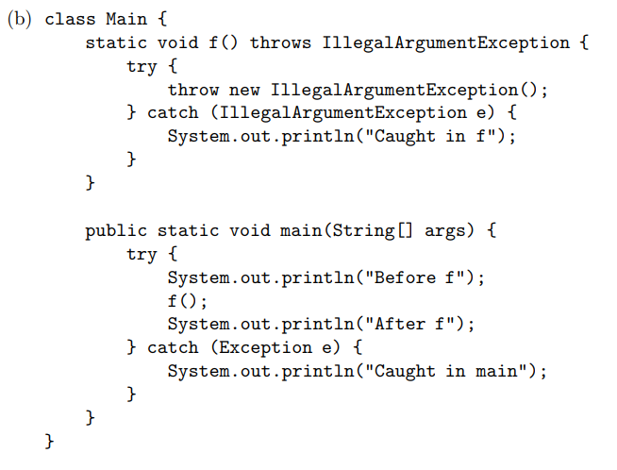
Q5
2.
3.
1.
4.

Slide 17
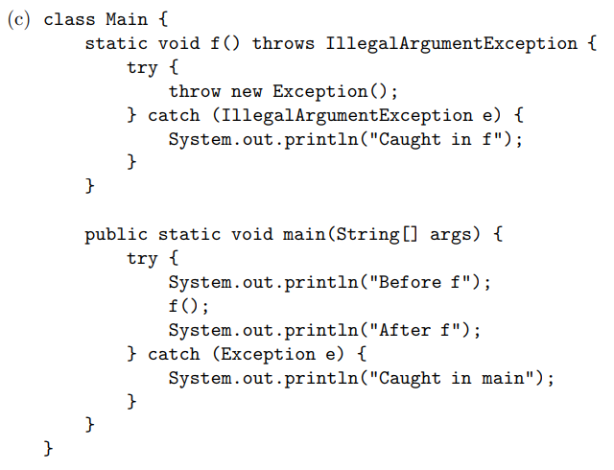
Q5
2.
1.

Slide 18
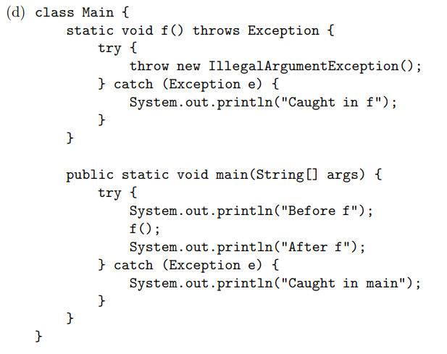
Q5
2.
3.
1.
4.

Slide 19
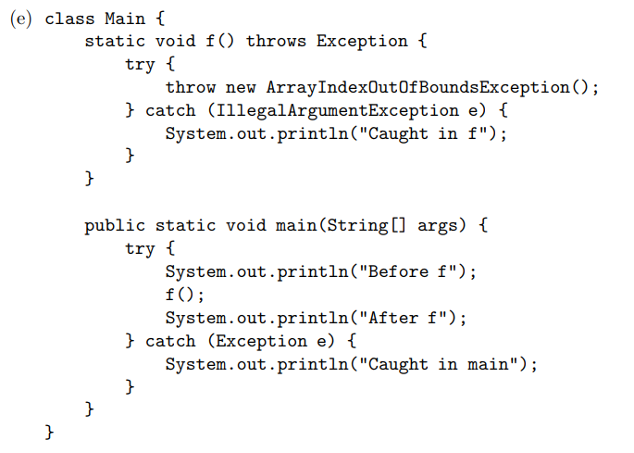
Q5
2.
Key Point:
Exception caught in first matching catch, program executes from there
1.
3.

Slide 20
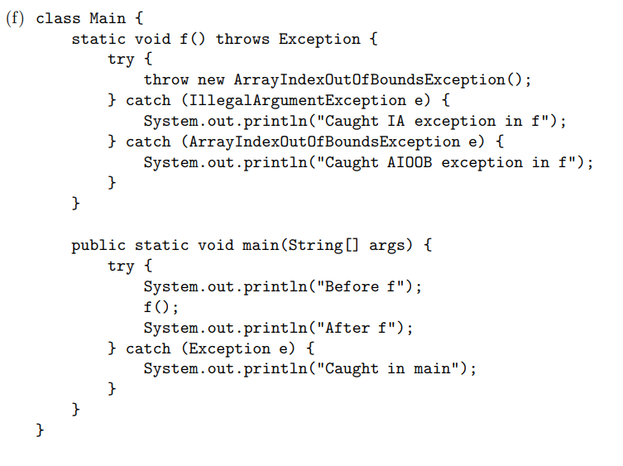
Q5
2.
3.
1.
4.

Slide 21
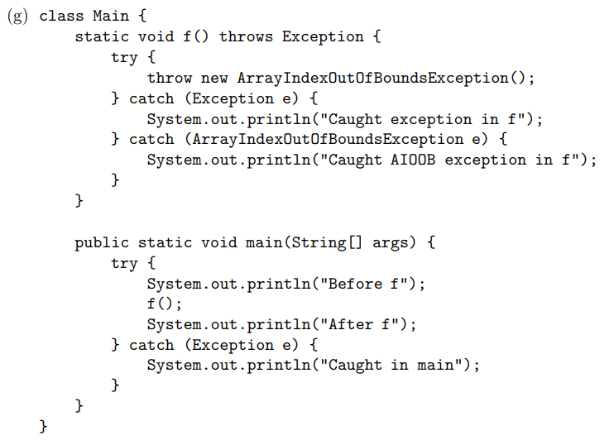
Q5
2.
3.
Never reaches here
Key Point:
Catch-all at the end, or better, don’t catch Exception
1.

Slide 22
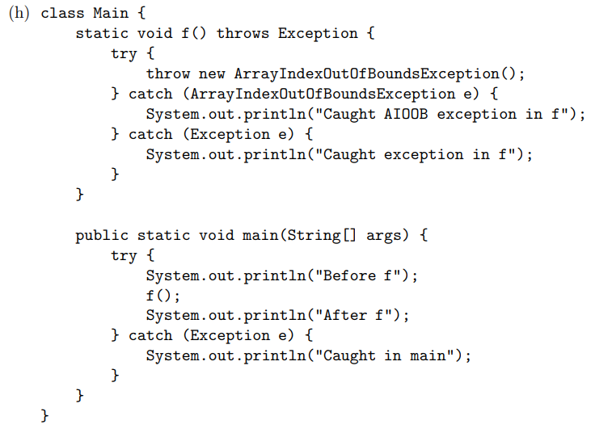
Q5
2.
3.
1.
4.

Slide 23
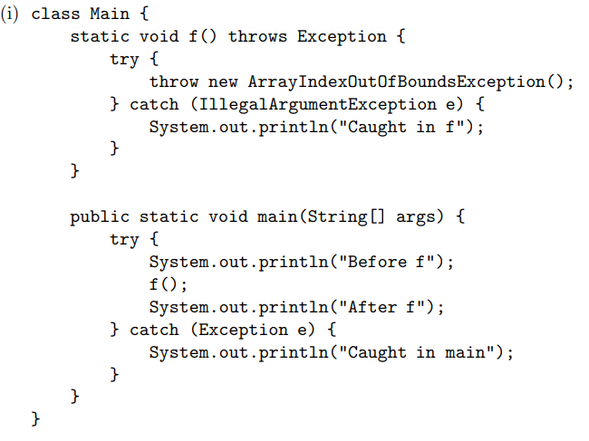
Q5
2.
1.
3.

